Slide 1
MPEG & Digital standards
By Ravi Kumar (19-Mar-2012)

Slide 2
Contents
MPEG History and Standards
MPEG-2 Video and Audio Compression
MPEG-2 System Layer
Creating a Transport Stream
Timing: PCR, DTS and PTS
MPEG-2 PSI Tables
DVB SI Tables
ATSC PSIP Tables
ISDB
Comparison of DTV Standards

Slide 3
MPEG
MPEG: The Moving Picture Experts Group (MPEG) is a working group of experts that was formed by ISO (International Organisation for Standardisation) and IEC (International Electrotechnical Commission) to set standards for audio and video compression and transmission.
Compression is the second crucial step to making digital TV a practical and profitable service. Compression enables the shift to digital television by drastically reducing the amount of data or bandwidth required to transmit a digitized program.
As a compression and transmission medium for digitized audio and video, today’s digital broadcast industry mainly relies on MPEG-2, the standard developed by the MPEG.
MPEG consists of a family of standards that specify the coding of video, associated audio and hypermedia. These currently include MPEG-1, MPEG-2, MPEG-4 and MPEG-7.
While all the MPEG standards deal with compression, only MPEG-2 addresses the transmission of compressed digital content across a network.

Slide 4
MPEG-1
MPEG-1 is the original standard for audio and video coding. First published in 1993, this standard defines digital audio and video coding at bitrates up to approximately 1.5 Mbps.
It is a frame based standard for delivering a single program on a CD ROM, and its quality is comparable to that of VHS cassettes.
MPEG-1 has also been used for digital radio broadcasts.
Soon after work on MPEG-1 began, champions of the “digital television” concept realized that MPEG-1’s syntax and structure would not support the complexity and versatility required by digital TV transmission.
For this reason, in 1990, work began on MPEG-2, the standard that would make digital television broadcasting a reality.

Slide 5
MPEG-2
MPEG-2 was developed as a frame- or field-based standard that allows digital broadcasting applications to deliver multiplexed programs efficiently.
MPEG-2 is backward compatible with MPEG-1, meaning that MPEG-1 video streams can be processed by MPEG-2 decoders.
MPEG-2 is a standard for “the generic coding of moving pictures and associated audio”.
MPEG-2 is a set of standards for building a single digital transport stream, or multiplex, which can carry more number of programs, depending upon the level of compression used and the communications bandwidth available.
MPEG standard covers rules for:
Compressing audio and video content
Transporting the multiplex across a network
Encapsulating data into the multiplex

Slide 6
MPEG-2
What the MPEG-2 standard does not regulate is the handling of multiple transport streams simultaneously.
Because a set-top box, or Integrated Receiver Decoder (IRD), operating in a live network environment must be able to manage several transport streams simultaneously, extensions to the MPEG-2 system layer were developed by Digital Video Broadcasting (DVB) and Advanced Television Systems Committee (ATSC).
MPEG-3 deals with standardizing scalable and multi-resolution compression and was intended for HDTV compression but was found to be redundant and was merged with MPEG-2, as a result there is no MPEG-3 standard.
MPEG-3 is not to be confused with MP3, which is MPEG-1 Audio Layer III

Slide 7
MPEG-4
MPEG-4 represents the latest breakthrough in audiovisual coding.
It allows for simultaneous coding of synthetic and natural objects and sound, giving service providers more options for creating games and other multimedia applications.
It extends interactive possibilities by allowing the user to manipulate things like views and the viewing perspective.
MPEG-4 supports the application of different compression routines to different parts of a frame, resulting in considerable processing efficiency and allowing for the coding of arbitrarily shaped objects, instead of the standard rectangular video frame.

Slide 8
MPEG-4
Because of this, it provides even greater compression than MPEG-1 or MPEG-2 and will be used for applications with especially limited transmission capacity.
Though digital broadcast will continue to use MPEG-2 standard, MPEG-4 will serve a variety of applications including networked video applications, computer games and wireless services.
In addition, programs compressed using MPEG-4 techniques can be encapsulated into MPEG-2 transport streams.
MPEG-4 AVC (H.264) may be used on HD DVD and Blu-ray Discs, along with VC-1 and MPEG-2.

Slide 9
MPEG-7
Formally called ‘Multimedia Content Description Interface’, the MPEG-7 specification will provide standardized descriptions for searching, filtering, selecting and handling audiovisual content.
These descriptions called Metadata, will allow users in various applications to search and manage volumes of audio and video files.
Applications include digital libraries, multimedia directory services, broadcast media selection and multimedia editing.
It was designed to standardize:
A set of Description Schemes (DS) and Descriptors (D)
A language to specify these schemes, called the Description Definition Language (DDL)
A scheme for coding the description
The combination of MPEG-4 and MPEG-7 has been sometimes referred to as MPEG-47.

Slide 10
MPEG-2 Video and Audio Compression
By extracting redundant information from a video or audio stream, MPEG-2 compression shrinks the signal to as much as 180 times smaller than its original size.
Once the stream arrives at the viewer’s home, the set-top box then re-generates the original content and presents the program to the viewer.
Compression allows broadcasters to transmit 6-10 times the number of programs or services they once offered, without needing to increase the size of the transmission pipe.
With the additional bandwidth, they can offer more programming, High-Definition Television (HDTV), internet services and/or interactive TV.

Slide 11
MPEG-2 Video and Audio Compression
The more a signal is compressed, the lower the resulting quality will be.
Using MPEG Compression techniques, a signal can be compressed considerably before picture quality is compromised, but where greater compression is required to preserve bandwidth, program quality may be sacrificed.
The MPEG-2 standard allows a flexible trade-off between image quality and bit rate to accommodate a wide range of quality requirements and bandwidth availability.
MPEG-2 specifies several different profiles and levels that allow broadcasters to determine the degree of compression vs. quality that best fits their application.

Slide 12
MPEG-2 Video Compression
Once video content is digitized, compression can begin.
Video compression takes advantage of the considerable redundancy that exists within each video frame and between consecutive frames.
With the use of video compression, up to 98% of the original digital signal can be removed without an unacceptable degradation in image quality.
There are two main types of MPEG video compression, spatial encoding and temporal encoding.
Spatial Encoding eliminates redundancy between adjacent pixels in a video frame.
It also makes use of the eye’s inability to detect certain visual degradations including noise in a “busy” picture area.

Slide 13
MPEG-2 Video Compression
Spatial encoding relies on similarities between adjacent pixels in plain areas of a picture.
For instance, a picture that contains a blue sky background will likely contain several rows identical blue pixels.
Spatial encoding can code only one set of these pixels and then indicate that the rest are identical, thus eliminating redundant data from the bit stream.
The spatial encoding process involves the following steps:
Discrete Cosine Transform (DCT)
Quantization
Weighting
Scanning
Entropy coding

Slide 14
MPEG-2 Video Compression
Discrete Cosine Transform (DCT) divides a picture into blocks of 8x8 pixels then transforms the pixel intensities into a series of frequency-based values, or coefficients.
Because of spatial redundancy, many of the coefficients end up with zero or near-zero values. These can be dropped from the series of coefficients so the video frame is expressed in as few bits as possible.
The result is lossy compression that eliminates some detail, but the level of detail discarded is so fine as to be imperceptible to the human eye.
Sometimes, however even greater compression is needed, so the word length of the remaining coefficients must be expressed in even fewer bits.
Again reducing additional bits comprises the accuracy of the digitized video stream and introduces some additional degradation into the picture.

Slide 15
MPEG-2 Video Compression
Following DCT, the video frame is quantized, meaning that coefficients are reorganized in order of visual importance.
After quantization, the weighting process strategically places degradation, or noise, into more detailed or complex picture areas where the viewer is least likely to notice it.
The DCT coefficients are then scanned such that the most significant coefficients are sent first, followed by less significant coefficients and finally an indication in the code that the remaining coefficients are all zero.
The final step in spatial encoding is entropy coding which resizes coefficients based on the number of times they occur.
Frequently repeated coefficients are expressed in the fewest number of bits, thus greatly decreasing the total bandwidth needed to transmit the coefficients.

Slide 16
MPEG-2 Video Compression
Temporal Encoding eliminates redundancy between sequential frames in the video frame.
Temporal coding takes advantage of the similarities between sequential frames and encodes only the differences from one frame to the next.
This is accomplished through two types of temporal encoding: inter-frame prediction and motion prediction.
Inter-frame prediction takes advantage of the similarities between sequential frames by encoding a complete reference frame only periodically, and then using that frame to predict the preceding and following frames.
The reference frame is called an Intra-coded frame, or I-frame. I-frames are used as a reference to predict P-frames and B-frames.

Slide 17
MPEG-2 Video Compression
Predicted frames, or P-frames, reference either a previous I-frame or a P-frame.
This means that instead of transmitting all the DCT coefficients for a P-frame, the encoder transmits only those coefficients that differ from the preceding I-frame or P-frame.
At the decoder, P-frames are re-created using I- or P-frame as a reference and applying the differentials.
Bidirectional predicted frames, or B-frames, are predicted in the same fashion from either preceding or subsequent I- or P-frames.
When a P-frame generally requires ½ of the data needed to create an I-frame, a B-frame requires only ¼.

Slide 18

MPEG-2 Video Compression
Using only one I-frame as a basis for creating all the other frames in a video stream would leave the stream extremely vulnerable to error, since an error in the I-frame would propagate throughout the entire sequence.
For this reason, frames are divided into Group of Pictures (GOPs), usually 12-15 frames long.
Each GOP begins with an I-frame, providing for rapid error correction when an I-frame begins corrupted.
GOPs also contain P-frame and B-frame. Below is one example of a GOP.

Slide 19
MPEG-2 Video Compression
Motion prediction takes advantage of the similarity by measuring an object’s motion at the encoder and sending a motion vector to the decoder.
Though objects may change location on the screen, their appearance often remains the same.
The decoder uses the motion vector to shift the specified image from its location in the previous frame to a new location in the next frame.
Thus moving objects only need to be encoded once and then moved as necessary between frames.
Typically, motion continues across several frames, so even greater compression can be attained when vectors are transmitted differentially.

Slide 20
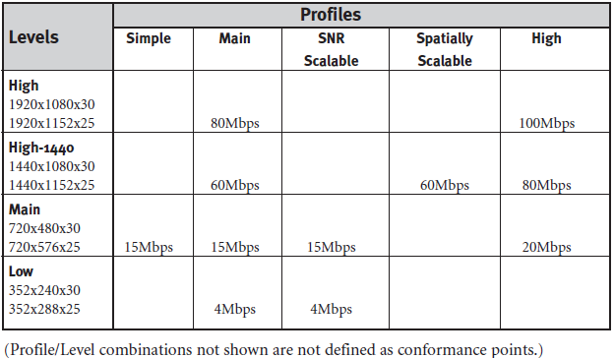
MPEG-2 Video Compression
Profiles and Levels:
To offer broadcasters greater flexibility when it comes to encoding complexity and picture size, the MPEG-2 standard specifies several different compression options known as profiles and levels.
Profiles dictate coding complexity while levels specify the number of pixels per frame.
The table below shows the various profiles and levels specified by MPEG-2 and the maximum bit rate for each combination.

Slide 21
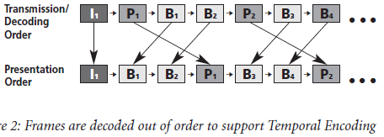
Decoding the Compressed Video Stream
Decoding an MPEG-2 video stream reverses the encoding process one for one.
An inverse DCT process restores frequency coefficients according to the accuracy of the encoder.
The decoder then uses transmitted macro blocks from I- and P-frames to replace redundant macro blocks discarded from P- and B- frames during encoding.
Motion vectors specify the location of these macro blocks within the predicted frames.
Inter-frame prediction requires that frames be sent to the decoder out of sequence and stored temporarily in a buffer.
For instance, in order for the decoder to re-create a B-frame, data from both the previous and next pictures must be available. Consider the order in which the frames in the above sequence must be decoded before they can be presented to the viewer:

Slide 22
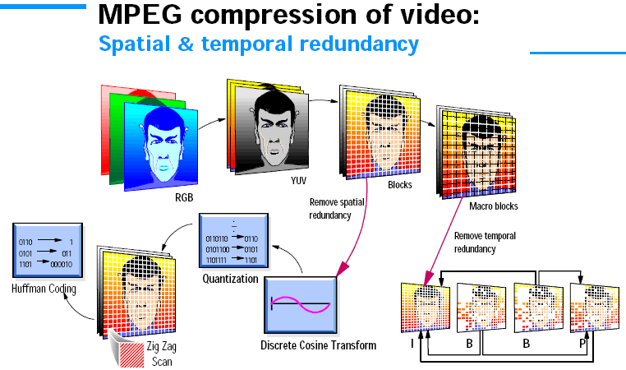
MPEG-2 Video Compression

Slide 23
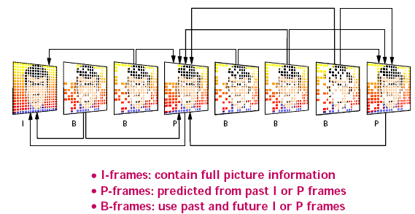
MPEG-2 Video Compression

Slide 24
MPEG-2 Audio Compression
MPEG-2 audio compression exploits the limitations of the human ear.
It relies on “masking”, or the ear’s inability to detect a sound in the presence of a similar louder sound.
There are two types of masking: auditory masking and temporal masking.
Auditory Masking occurs when two sounds with similar frequencies occur at the same time.
If one sound is louder than the other, it will completely drown out the second sound.
For example, auditory masking occurs when you try to carry on a quiet conversation in a train station. Passing trains drown out your conversation each time they speed by.
In the presence of the sound generated by the train, the quiet voices in the conversation become imperceptible.

Slide 25
MPEG-2 Audio Compression
The closer two signals are in frequency, the more likely it is that the louder sound will drown out the softer one, though the second sound may be slightly softer.
For example, if two horns are playing at two similar frequencies, the quieter horn can not be heard.
But a bass drum playing at the same sound level as the quieter horn is likely to be heard, since its frequency differs significantly from that of the louder horn.
Because the sensitivity of the ear is frequency dependent, the masking is also frequency dependent.
Sounds at lower frequencies must be even closer together in order to be masked than sounds at higher frequencies.

Slide 26
MPEG-2 Audio Compression
Temporal Masking occurs when a loud sound drowns out softer sounds immediately before and after it.
There is a range of time several milliseconds long before and after a loud masking sound during which its masking effects will still be present.
For instance, the blast of a train whistle will likely drown out a faint beep that directly follows it.
In order to capitalize on these auditory characteristics, the audio compression algorithms break the audio spectrum into many sub-bands.
The dynamic range in each sub-band is reduced separately such that the effects of a dynamic range’s compression are not noticeable.

Slide 27
MPEG-2 Audio Compression
Instead of 16 bits per audio sample in each sub-band, there might only be 2-4 bits per sample. A scaling constant for each band is also used.
The allocation of bits per sub-band is divided such that the important frequency ranges receive more weight.
The size of a sub-band also varies by frequency in order to match the masking by frequency in the human ear.
An audio signal is compressed in blocks such that the allocation of frequency information can be changed over time and time masking can be used effectively.
The size of an audio block is 24 milliseconds.

Slide 28
MPEG-2 Transport: The System Layer
We have discussed about compressing and decompressing a single video or audio stream, but MPEG-2 transport streams simultaneously carry many programs or services with audio, video and data all interlaced together.
A decoder must be able to sort through the transport stream, organizing the video, audio and data streams by program or service.
It must also know when to present each part of the program or service to the viewer. This is where the MPEG-2 System Layer comes into play.

Slide 29
MPEG-2 Transport: The System Layer
The system layer specifies the structure of the transport stream, the transmission mechanism for MPEG-2 compressed data.
Among other things, this structure provides for rapid synchronization and error correction at the decoder.
The system layer also defines Program Specific Information (PSI) tables.
These act as a table of contents, allowing the decoder to quickly sort and access information in the transport stream.

Slide 30
Creating a Transport Stream
A digital TV signal is transmitted as a stream of MPEG-2 data known as a Transport Stream.
Each transport stream has a data rate of up to 40 megabits/second for a cable or satellite network, which is enough for 7 or 8 separate TV channels, or approximately 25 megabits/second for a terrestrial network.
The MPEG-2 transport stream mechanism is similar to IP transport in that MPEG-2 streams carry data that has been divided into transport packets, each with a header and a payload.

Slide 31
Creating a Transport Stream
Once a video or audio stream is compressed, it becomes an Elementary Stream.
Each elementary stream can contain either MPEG-2 encoded audio, MPEG-2 encoded video, or data encapsulated in an MPEG-2 stream.
Each of the elementary streams has a ‘Packet Identifier’ (usually known as a PID) that acts as a unique identifier for that stream within the transport stream.
The only restriction on the number of elementary streams in any transport stream is that each elementary stream must have a unique PID value within its containing transport stream.
Since this is stored as a 13-bit value, this is not a major restriction.

Slide 32
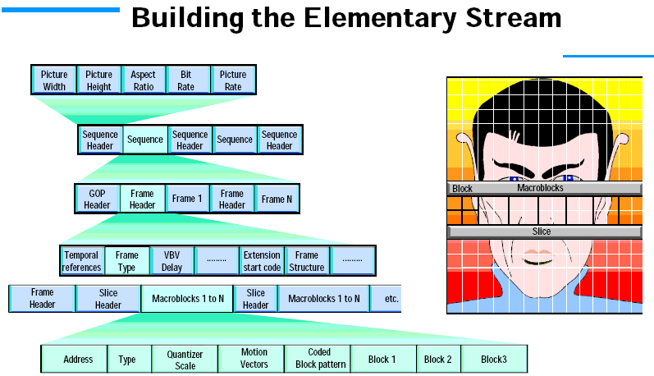
Creating a Transport Stream

Slide 33
Creating a Transport Stream
In practise, the number of elementary streams is limited by the total bit rate of the transport stream.
Transmission issues mean that transport stream with bitrates much above 40 megabits/second can’t usually be transmitted reliably.
A transport stream consists of number of audio and video streams that are multiplexed together.
First, each service in the transport stream will have its audio and video components encoded using MPEG-2 compression.
The result of this process is a set of MPEG-2 elementary streams, each containing one video channel or one (mono or stereo) audio track.

Slide 34
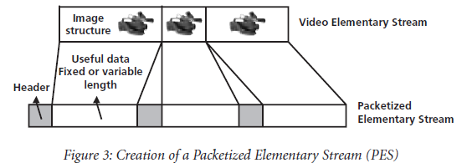
Creating a Transport Stream
These streams are simply a continuous set of video frames or audio data, which is not really suitable for multiplexing.
Therefore, we split these streams into packets in order to make the multiplexing process easier. The result of this is a Packetized Elementary Stream (PES) with variable-length packets, each containing a header and a payload.
The payload contains a single frame of video or audio. The header includes timing information that tells the decoder when to decode and present the frame.

Slide 35
Creating a Transport Stream (PES)

Slide 36
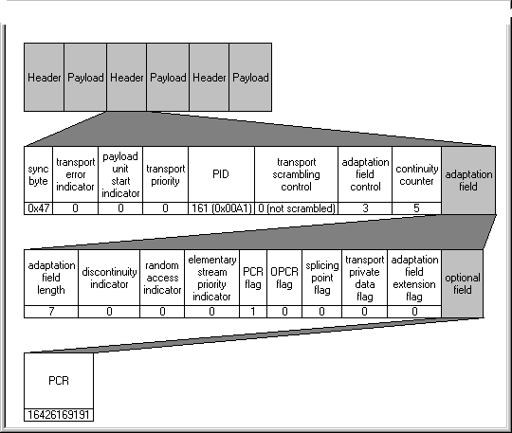
Creating a Transport Stream (Packet Header)

Slide 37
Creating a Transport Stream
If the information carried in the header is corrupted, the entire PES packet will be lost.
The key features of a Packet Header are as follows:
Sync Byte sets the start of a TS packet and allows transmission synchronization.
Transport Error indicator indicates the packet is in error.
Packet Identifier (PID) enables the decoder to sort through the packets in a transport stream to reconstruct programmes.
Program Clock Reference (PCR) provides 27MHz clock recovery information.

Slide 38
Creating a Transport Stream
During the encoding process, the packetized elementary streams are packetized again and the data from the stream is stored in transport packets.
Each transport packet has a length of 188 bytes, which is much smaller than a PES packet and so a single PES packet will be split across several transport packets.
The packet size was initially chosen to simplify mapping of MPEG-2 packets over ATM (Asynchronous Transfer Mode), which uses cells with a payload of 47 bytes (47x4=188).
Like the PES packet, each transport packet also contains a header and a payload.
This extra level of packetization allows the stream to support much more powerful error correcting techniques.

Slide 39
Creating a Transport Stream
PES packets are used to provide a way of multiplexing several streams into one bigger stream and are more concerned with identifying the type of data contained in the packet and the time and which it should be decoded and displayed.
Transport packets on the other hand are almost purely concerned with providing error correction.
Once the audio or video stream has been divided into transport packets, it is multiplexed, or merged with similarly packetized content for other services.
A multiplex composed of one or more services is called a Transport Stream.

Slide 40
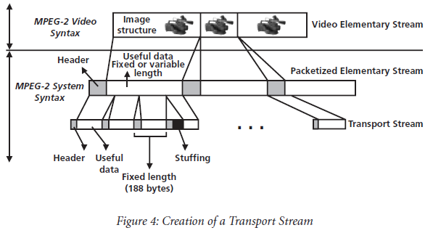
Creating a Transport Stream
Each packet in the transport stream, whether it contains audio, video tables or data is identified by a number called a PID or Packet Identifier.
PIDs enable the decoder to sort through the packets in a transport stream.

Slide 41
Creating a Transport Stream
So far we have just considered audio and video data. We may also want to include data streams as part our service for applications, Teletext, Subtitle info etc.
MPEG provides a well defined way of carrying non-AV data inside transport packets. These are called private sections.
Since most of the equipment that generates this data will produce a stream of transport packets containing private sections, multiplexing them into transport stream is easy.
Once we have a complete set of transport packets for the different parts of our services, we can insert them into our final transport stream.
When doing this, we have to be careful to insert packets in the correct order.
This is not just a case of ensuring that all of the packets within the stream come in the right order – MPEG defines a strict buffering model for MPEG decoders.

Slide 42
Creating a Transport Stream
We have to take care that each elementary stream in our transport stream is given a data rate that is constant enough to ensure that the receiver can decode that stream smoothly with no buffer underruns or overruns.
We also have to take care because video streams will use a much larger proportion of the final transport stream than audio streams and so we can’t simply insert a packet from each stream in turn.
A ratio of ten video packets to every audio packet is fairly close to what we would likely see.

Slide 43
Timing: PCR, DTS and PTS
Timing in the transport stream is based on the 27MHz System Time Clock (STC) of the encoder.
To ensure proper synchronization during the decoding process, the decoder’s clock must be locked to the encoder’s STC.
In order to achieve this lock, the encoder inserts into the transport stream a 27MHz time stamp for each program.
This time stamp is called the Program Clock Reference, or PCR.
Using the PCR, the decoder generates a local 27MHz clock that is locked to the encoder’s STC.

Slide 44
Timing: PCR, DTS and PTS

Slide 45
Timing: PCR, DTS and PTS
As we mentioned earlier, compressed video frames are often transmitted out of order.
This means that preceding I-frames and following P-frames used to regenerate B-frames must be available in the decoder well before its presentation time arrives.
To manage this critical timing process, there are two time stamps in the header of each PES packet, the Decoding Time Stamp (DTS) and the Presentation Time Stamp (PTS).
DTS tells the decoder when to decode the frame.
PTS tells the decoder when to present the frame.
If the DTS for a frame precedes its PTS considerably, the frame is decoded and held in a buffer until its presentation time arrives.

Slide 46
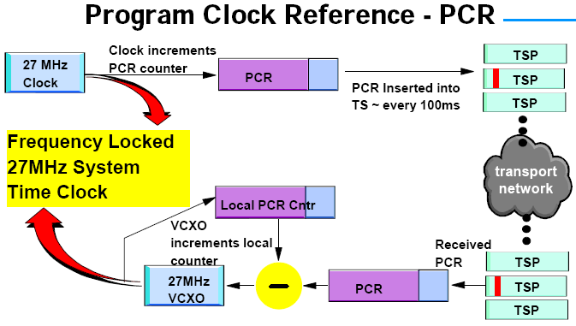
Timing: PCR, DTS and PTS

Slide 47
Timing: PCR, DTS and PTS
Before the transport stream is created, the encoder adds PTSs and DTSs to each frame in the PES.
It also places the PCR for each program into the transport stream.
Inside the decoder, the PCR goes through a Phase Lock Loop (PLL) algorithm, which locks the decoder’s clock to the STC of the encoder.
PLL is a control system that generates an output signal whose phase is related to the phase of an input ‘reference’ signal.
At the decoder end, it uses a Voltage Controlled Oscillator (VCXO) to generate a 27MHz clock.
This synchronizes the decoder with the encoder so that data buffers in the decoder do not overflow or underflow.

Slide 48
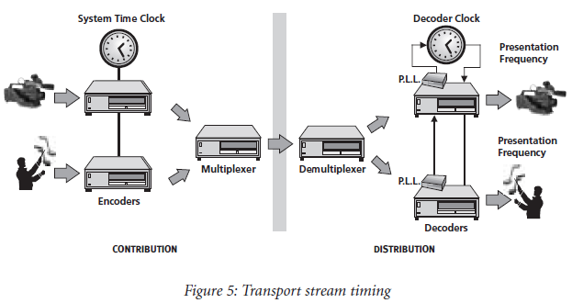
Timing: PCR, DTS and PTS
Once the decoder’s clock is synchronized, the decoder begins decoding and presenting programs as specified by the DTS and PTS for each audio or video frame.
The following figure shows the timing sequence in the transport stream.

Slide 49
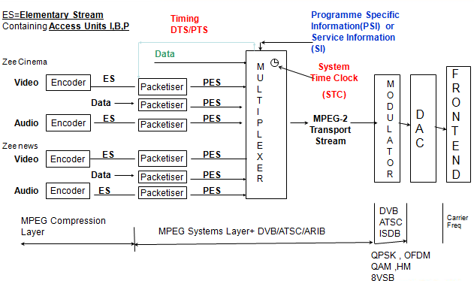
MPEG-2 Compression and Transport Stream

Slide 50
Service Information
If we just multiplexed these transport packets together, we would have a transport stream that contains number of elementary streams with no indication of what type of data is in these streams or how to reconstruct these streams into something that a receiver can present to the user.
To solve this problem, MPEG and DVB both specify that other information should be added to transport stream.
This data is encoded in a number of elementary streams that are added to the transport stream during the multiplexing process, and is known as Service Information.
Basically, it’s a simple database that describes the structure of the transport stream. It contains a number of tables that each describe one service in the transport stream.

Slide 51
MPEG-2 PSI Tables
As viewers may choose multiple programs on a single transport stream, a decoder must be able to quickly sort and access video, audio and data for the various programs.
MPEG-2 defined Program Specific Information (PSI) tables acts as a table of contents for the transport stream, providing the decoder with the data it needs to find each program and present it to the viewer.
PSI tables help the decoder locate audio and video for each program in the transport stream and verify Conditional Access (CA) rights.
The tables are repeated frequently (e.g. 10 times/sec) in the stream to support random access required by a decoder turning on or switching channels.

Slide 52
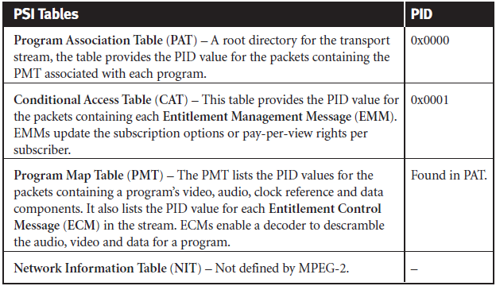
MPEG-2 PSI Tables
The following table gives a basic overview of the PSI tables.

Slide 53
Program Association Table (PAT)
The Program Association Table (PAT) is the decoder’s first stop when attempting to locate a program.
The decoder quickly finds the PAT because it always located on PID 0x0000.
Like the index of an atlas, it tells the decoder where to find the “map” for each program in the transport stream.
This map is contained in the Program Map Table (PMT) for each program.
The PAT tells the decoder the PID value for the packets containing each program’s PMT.

Slide 54
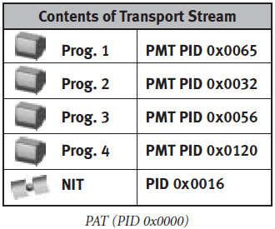
Program Association Table (PAT)
The PAT may also contain the PID value for the packets containing the Network Information Table (NIT), which provides access to other transport streams in the network.

Slide 55
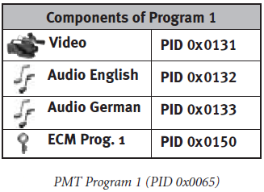
Program Map Table (PMT)
Each Program Map Table (PMT) literally maps out a specific program, listing the PID values for the packets containing the program’s video, audio and data components.
With this information, the decoder can easily locate, decode and display the program’s contents.
The PMT also indicates the PID value for a program’s Entitlement Control Message (ECM). The ECM supplies the decoder with the keys necessary to descramble the audio and video for a program.

Slide 56
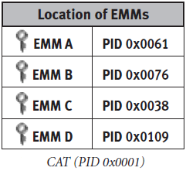
Conditional Access Table (CAT)
The MPEG-2 syntax enables broadcasters to transmit proprietary Conditional Access information in the transport stream in the form of Entitlement Management Messages (EMMs).
EMMs update the subscription options or pay-per-view rights for each subscriber or for groups of subscribers.
The Conditional Access Table (CAT) tells the decoder where to find EMMs in the transport stream by listing the PID value for the packets containing each EMM.
The CAT is always found on PID 0x0001.

Slide 57
Network Information Table (NIT)
The Network Information Table (NIT) provides information regarding a network on which various transport streams reside.
This table is specified, but not defined by MPEG-2.
It is defined by DVB.
The ATSC standard does not use this table.

Slide 58
Decoding with PSI Tables
The following steps outline the process followed by a decoder to display a certain program, in this case Program 1:
Create the PAT. To do this, extract the contents of packets with PID=0x0000 and build the PAT.
Read the PAT to identify the PID of the packets carrying the PMT for Program 1. The PAT shows the PMT PID for Program 1 is on PID=0x0065.
Extract the contents of the packets with PID=0x0065 and build the PMT.
Read the PMT for Program 1 to find the PIDs that identify the audio and video packets and PCR for Program 1. The PMT shows the video to be in packets with PID=0x0131, the German audio in packets with PID=0x0132 and the English in packets with PID=0x0133. In most cases, the PID for the video stream also carries the PCR.

Slide 59
Decoding with PSI Tables
In the PMT, find the ECM PID for Program 1. The PMT shows the ECM to be in packets with PID=0x0150.
Locate packets with PID=0x0150 and extract the ECM for Program 1.
Extract the video for Program 1 from packets with PID=0x0131.
If the user has selected the German sound track, locate and extract the audio track from packets with PID=0x0132. If the user has requested the English sound track, locate and extract the audio from packets on PID=0x0133.
Using the ECM on PID=0x0150, descramble the video and audio for Program 1.
Assemble the video and audio into PESs.
Use the DTS and PTS in the header of each PES packet to determine when to decode and present the packet’s contents to the viewer.

Slide 60
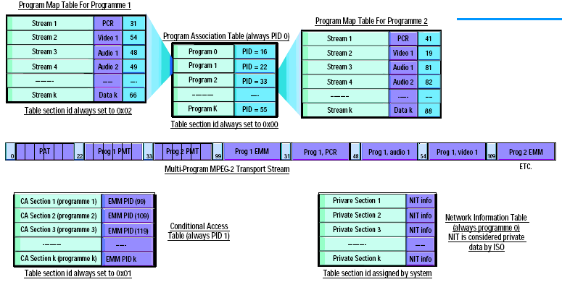
MPEG-2 PSI Tables Structure

Slide 61
Digital Video Broadcasting (DVB)
While MPEG-2 PSI tables enable the decoder to decipher the programs on a single transport stream, they do not provide enough information to support the numerous programs and services available on an entire network of transport streams.
The Digital Video Broadcast (DVB) standard defines a set of tables, called Service Information (SI) tables that extend the capabilities of the MPEG-2 system layer such that a decoder can receive and decode any number of programs and services across a network of transport streams.

Slide 62
DVB History
The DVB project began in September 1993 when public and private television organizations from across Europe signed an agreement to work together for the creation of a digital broadcasting standard.
The organization developed international standards for satellite, cable and terrestrial transport.
The project now includes over 290 participants in more than 35 nations worldwide.
MPEG-2 video compression standard and transport mechanism is same for DVB.
Audio compression standards uses MPEG-1 & 2 or Dolby AC3 audio.

Slide 63
DVB SI Tables
DVB Service Information (SI) tables give service providers the tools necessary to offer programs and services across a large network of transport streams.
These tables are added to the MPEG-2 transport stream during encoding or multiplexing.
They work together with MPEG-2 PSI tables to give the decoder access to all available programming across an entire network.
SI tables also provides information for the Electronic Program Guide (EPG), which shows viewers a description of all current and upcoming events, along with their start time and duration.
Like all other packets in the transport stream, those that contain SI tables are identified by PID number.

Slide 64
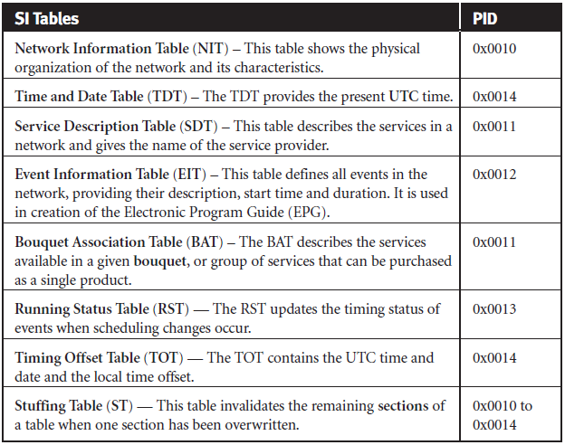
DVB SI Tables
The following table gives a basic overview of the SI tables.

Slide 65
Time and Date Table (TDT)
The Time and Date Table (TDT) provides the present UTC date and time, which can be adjusted according to time zone and presented on the screen for the viewer.

Slide 66
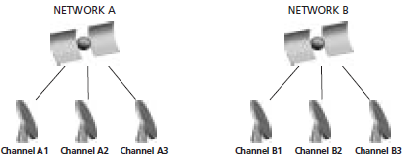
Network Information Table (NIT)
The Network Information Table (NIT) contains network characteristics and shows the physical organization of the transport streams carried on the network.
The decoder uses the tuning parameters provided in this table to change the channels at the viewer’s request when the desired program is not on the current transport stream.
Tuning parameters are specific to the type of transmission assigned to the network, whether it be terrestrial, cable or satellite.

Slide 67
Service Description Table (SDT)
The Service Description Table (SDT) defines the services available on the network and gives the name of the service provider.
A service is a sequence of events that can be broadcast as part of a schedule.
Two types of SDTs, “Actual” and “Other”, are required by DVB.
The SDT Actual describes the services available on the transport stream currently being accessed by the viewer.
The SDT Other describes services available on all other transport streams in the network.

Slide 68
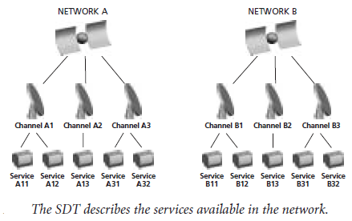
Service Description Table (SDT)

Slide 69
Event Information Table (EIT)
The Event Information Table (EIT) defines all the events in the network, including their description, start time and duration.
According to MPEG an event is a collection of elementary streams with a common time base set to start and end at the same time.
We often refer to events as “TV programs”.
Three different types of EITs can be transmitted simultaneously: the EIT Present, the EIT Following and the EIT Schedule.
The EIT Present describes the events currently being broadcast on the transport stream being accessed by the viewer.
The EIT Following provides information about the next events to be broadcast on the same transport stream.

Slide 70
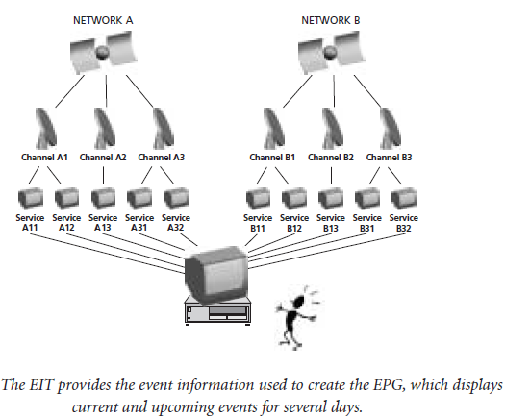
Event Information Table (EIT)
The EIT Schedule lists all events available on the network for anywhere from the next few hours to the next few days, depending on the service provider’s implementation. It provides the main source of information for the EPG.

Slide 71
Optional DVB SI Tables
Four optional DVB SI tables can also be included in the stream. They are:
Bouquet Association Table (BAT) – A Bouquet is a commercial offering or group of services that can be purchased as a single product. The BAT describes the services available in a given Bouquet.
Running Status Table (RST) – This table carries information used to update the timing status of events in the system when scheduling changes occur. This saves broadcasters from having to retransmit an entire table when only a portion of the content changes.
Timing Offset Table (TOT) – This table contains the UTC time and date, along with the local time offset.
Stuffing Table (ST) – This table invalidates the remaining sections in a table when one section has been overwritten. This maintains the integrity of the section_number field.

Slide 72
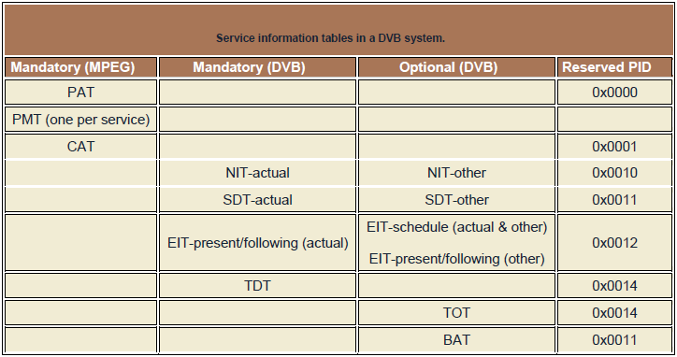
SI Tables in a DVB System

Slide 73
Advanced Television Systems Committee
Like the DVB specification, the Advanced Television Systems Committee (ATSC) standard expands the MPEG-2 system layer to support the simultaneous transmission of multiple transport streams in a broadcast network.
As we mentioned previously, the MPEG-2 system layer only enables a decoder to locate the programs and services available on a single transport stream.
To broaden this capacity the ATSC defined its own set of tables called Program and System Information Protocol (PSIP) tables.
These give the decoder access to tuning parameters, program ratings, and event description for all channels in the network.
In conjunction with MPEG PSI, ATSC PSIP tables make a larger number of products and services available to the viewer.

Slide 74
ATSC History
The U.S. Federal Communications Commission (FCC) adopted the major elements of the ATSC Digital Television Standard (A/53) in 1996 for the nation’s next generation of broadcast television.
Similar aims to DVB but with more emphasis on HDTV at the outset.
This standard is mainly toward terrestrial broadcast, but it also includes provisions for Cable TV (CATV) transmission.
MPEG-2 video compression standard and transport mechanism is same for ATSC.
Audio compression standards uses Dolby AC3 audio.

Slide 75
ATSC PSIP Tables
ATSC’s Program and System Information Protocol (PSIP) tables provide the decoder with the necessary information to access all channels and events available on an MPEG-2/ATSC network.
They provide tuning information that allows the decoder to quickly change the channels at the click of the remote control.
In addition they include provisions for viewer-defined program ratings, and they provide event descriptions to support the creation of the EPG.

Slide 76
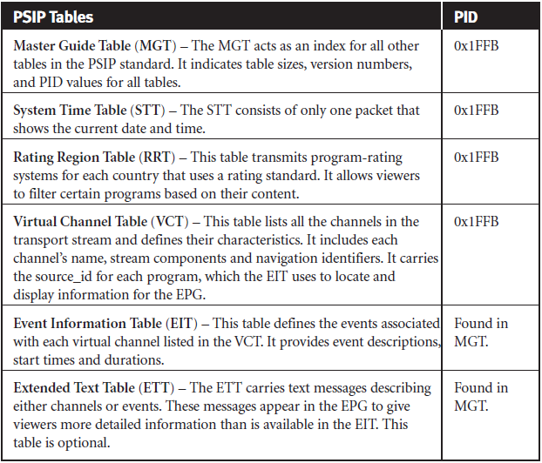
ATSC PSIP Tables

Slide 77
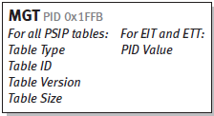
Master Guide Table (MGT)
The Master Guide Table (MGT) acts as an index for other PSIP tables. It defines
Table sizes, necessary for proper decoding.
Version numbers, which help to identify the tables that need to be updated.
PID values, which enable the decoder to locate the packets that contain the EITs and ETTs.

Slide 78
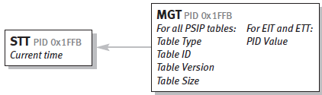
System Time Table (STT)
The System Time Table (STT) consists of only one packet, which serves as a reference for the current time of day.
This information enables the decoder to start advertised events on schedule.

Slide 79
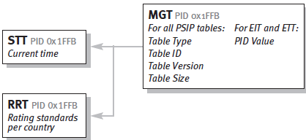
Rating Region Table (RRT)
The Rating Region Table (RRT) transmits program rating systems for each country that uses a rating standard.
The information in this table allows viewers to filter certain programs based on their content.
The decoder uses information in the MGT to locate and create the RRT.

Slide 80
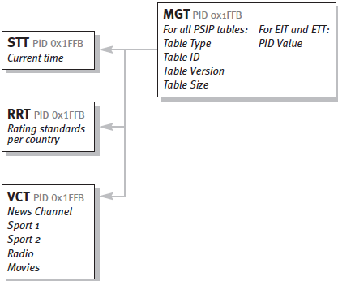
Virtual Channel Table (VCT)
The Virtual Channel Table (VCT) lists all the channels in the transport stream and defines their characteristics. This includes the channel name, the stream components, stream types and navigation identifiers.
The VCT also carries the source_id for each program, which the EIT uses to locate and display channel information for the EPG.
The decoders uses information in the MGT to find and build the VCT.

Slide 81
Event Information Table (EIT)
The Event Information Table (EIT) defines the events associated with each of the virtual channels listed in the VCT. It provides event descriptions, start times and durations. The decoder uses these to create the EPG.
According to ATSC specification, between 4 and 128 EITs must be in the transport stream at any given time.
Each EIT provides event information for a 3 hr time period, so up to 16 days of programming can be advertised in advance in the EPG.
EIT-0 always contains information for the current 3 hr time block, while EIT-1 defines programming for the next 3 hrs.
The PID value for each EIT is defined in the MGT, and the VCT supplies the channel identifier, or Source ID for each event in the EIT.

Slide 82
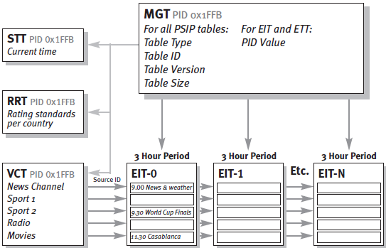
Event Information Table (EIT)

Slide 83
Extended Text Table (ETT)
Extended Text Tables (ETTs) carry text messages describing both channels and events; hence, there are two types of ETTs: Channel ETTs and Event ETTs.
ETT messages are displayed in the EPG to give viewers more detailed information than is available in the EIT.
For example, Channel ETTs may contain information about the price of a channel or its coming attractions. Event ETTs might include a short paragraph describing a specific event, such as a movie.
ETTs are optional, and the PID number of each ETT is defined in the MGT.

Slide 84
Integrated Services Digital Broadcasting
The Integrated Services Digital Broadcasting (ISDB) is a Japanese standard for digital television (DTV) and digital radio (DAB) used by the country’s radio and Television networks.
A derivative of ISDB, ISDB-T International, was developed by the Brazilian government and is being widely adopted in South America.
MPEG-2 video compression standard and transport mechanism is same for ISDB.
Audio compression standards uses MPEG AAC (Advanced Audio Coding) like MPEG-4.
The Association of Radio Industries and Businesses commonly known as ARIB is a standardization organization in Japan.
ARIB SI is additional tables defined by ARIB in Japan.

Slide 85
Comparison of DTV Standards
 | ATSC | DVB | ISDB
Country | America | Europe | Japan
Video encoding | MPEG-2 | MPEG-2 | MPEG-2
Audio encoding | Dolby AC3 | MPEG-1,2, Dolby AC3 | MPEG AAC
Modulation | QAM, 8 VSB digital modulation | QPSK, 8 PSK, QAM | ISDB-S: PSK ISDB-T: COFDM with PSK/QAM
SI Table | ATSC PSIP | DVB SI | ARIB SI

Slide 86
Thank You

